Slide 1



Effects of Microgravity on Stem and immune Cells
Presented by: Tyrene Hubbard
PI: Dr. David Harris
Arizona Space Grant Symposium
Tucson, Arizona
April 11, 2014

Slide 2
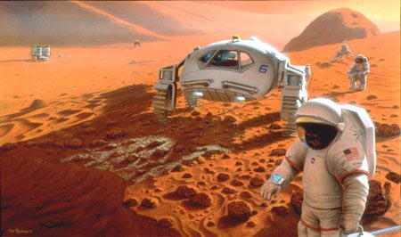
Introduction
2-year project
Extended space flight missions
  E.g., missions to mars
Use humanized murine mice
In Low-earth orbit gravity is decreased and microgravity is achieved
¹http://d1jqu7g1y74ds1.cloudfront.net/wp-content/uploads/2010/10/manned-mission-mars-illustration.jpg

Slide 3
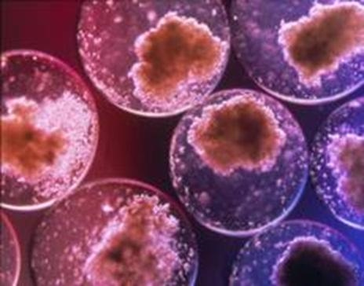
Why Stem Cells?
Flight missions have reported deleterious effects on body
  Immune system is weakened²
  Increase in stress hormone levels³
  Bone demineralizes⁴
  Pathogenic bacteria thrive in microgravity⁵
Immune and stem cells
  Will use humanized mice for the study Image courtesy of health centrics.net⁶
  Using umbilical cord blood derived stem cells
  Contains hematopoietic stem cells that will give rise to the human immune system

Slide 4
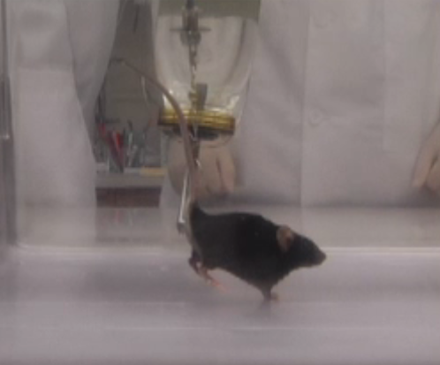
Why Hind-Limb Unloading?
Simulates the effects of microgravity
Also known as 45° head-down tilt
Can be compared to rapid-turnaround ISS experiments
In vivo system used for data collection and observation
Photo courtesy of Brown, M., Crissey, J.M., & Ferrira, J.A. (2011)⁷

Slide 5
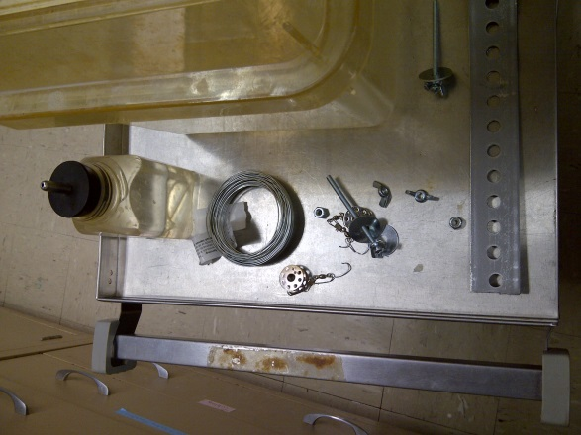
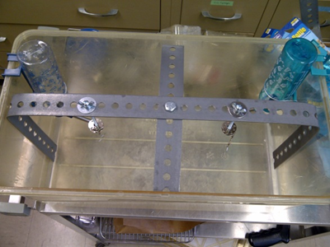
Methods
Construct cage and HU apparatus
Prepare murine mice for procedure
Suspend mice
Periodically assess immune and hematopoietic system of mice by:
  Cheek stick (blood collection)
  FACS (Fluorescence Activating Cell Sorting)
  CFU (Colony Forming Unit)
  BDM (Bone Density Mass)

Slide 6
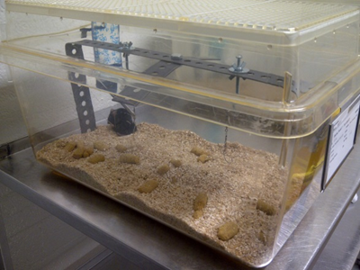
Results
Preliminary stage of study has started
Training completed for working with animals
Taking baselines before suspension
Now ready to suspend the mice and start experiment
Study will continue for the next two-years

Slide 7
Future Directions
Continue data collection on monthly basis
Determine if we can use animal model as a substitute for human experimentation
Learn, refine, and apply any new methods in reducing the deleterious effects of extended flight travel
Expand and contribute to spaceflight-microgravity knowledge base

Slide 8
Acknowledgments
Dr. David Harris
Dr. Michael Badowski
Susan Brew
Sam Roden
Arizona Space Grant Consortium
National Aeronautics Space Administration (NASA)

Slide 9
Citations
¹Atkinson, Nancy. (7 Oct 2010). Could a Human Mars Mission Be Funded Commercially? Universe Today. Image.
²Guéguinou, N, C Huin-Schohn, M Bascove, JL Bueb, E Tschirhart, C Legrand-Frossi, and JP Frippiat. "Could Spaceflight-Associated Immune System Weakening Preclude the Expansion of Human Presence Beyond Earth's Orbit?" Journal of Leukocyte Biology. 86.5 (2009): 1027-38. Print.
³Chapes, SK, SJ Simske, G Sonnenfeld, ES Miller, and RJ Zimmerman. "Effects of Spaceflight and Peg-Il-2 on Rat Physiological and Immunological Responses." Journal of Applied Physiology (bethesda, Md. : 1985). 86.6 (1999): 2065-76. Print.
⁴Sung, M, J Li, A.J Spieker, G.D Rosen, S.B Rutkove, J Spatz, R Ellman, M Bouxsein, V.L Ferguson, and T.A Bateman. "Spaceflight and Hind Limb Unloading Induce Similar Changes in Electrical Impedance Characteristics of Mouse Gastrocnemius Muscle." Journal of Musculoskeletal Neuronal Interactions. 13.4 (2013): 405-411. Print.
⁵Guéguinou, N., et al.
⁶Health centrics. (n.d.). Umbilical Cord Blood can be used to treat Diseases. Health Care & Alternative Medicine: Working for Healthier Life. Image.
⁷ Ferreira, J. A., Crissey, J. M., Brown, M. An Alternant Method to the Traditional NASA Hindlimb Unloading Model in Mice. J. Vis. Exp. (49), e2467, doi:10.3791/2467 (2011).
⁸larvalsubjects. (9 Dec 2010). Meeces in Space! Larval Subjects.Image.
http://larvalsubjects.wordpress.com/2010/12/09/meeces-in-space/

Slide 10
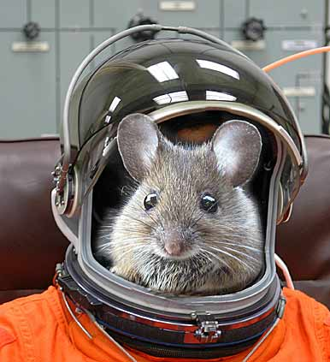
Thank You!
⁸http://larvalsubjects.files.wordpress.com/2010/12/mouse-in-space.jpg?w=272&h=300

